Slide 1

Sporadic ALS has compartment-specific aberrant exon splicing and altered cell matrix adhesion biology
Stuart J. Rabin¹, Jae Mun ‘Hugo’ Kim¹, Michael Baughn¹, Ryan T. Libby¹, Young Joo Kim¹, Yuxin Fan¹, Randell T. Libby², Albert La Spada², Brad Stone¹ and John Ravits^{1,3}
Presented by Bert Mouler
AS.410.713.81.SP14
Advanced Genomics and Genetics Analyses
Spring 2014
Notes:
1: Translational Research Program, Benaroya Research Institute at Virginia Mason, Seattle, WA 98101, USA
2: Center for Neurogenetics & Neurotherapeutics, University of Washington, Seattle, WA 98195, USA and 3Section of Neurology, Virginia Mason Medical Center, Seattle, WA 98101, USA
References:
Rabin, Stuart J., et al. "Sporadic ALS has compartment-specific aberrant exon splicing and altered cell–matrix adhesion biology." Human molecular genetics 19.2 (2010): 313-328.

Slide 2
Amyotrophic Lateral Sclerosis
Fatal neurodegenerative disease
AKA Lou Gehrig’s disease
Characterized by muscle atrophy, muscle spasticity, and difficulty speaking, swallowing, and breathing
Due to degeneration of the upper and lower motor neurons
Pathogenic mechanisms are unknown
Several genetic mutations have been associated with ALS
~5,000 people diagnosed with ALS per year in the US
~4-8 people per 100,000 worldwide
Notes:
References:
Rabin, Stuart J., et al. "Sporadic ALS has compartment-specific aberrant exon splicing and altered cell–matrix adhesion biology." Human molecular genetics 19.2 (2010): 313-328.
Rowland, Lewis P., and Neil A. Shneider. "Amyotrophic lateral sclerosis." New England Journal of Medicine 344.22 (2001): 1688-1700.

Slide 3
Background
12 sporadic ALS and 10 control lumbar spinal cords acquired by a rapid autopsy system
44 total samples
2 RNA pools
from motor neurons collected by laser capture microdissection
from the surrounding anterior horns
Isolated RNA, amplified mRNA, profiled whole-genome exon splicing, and analyzed results
Findings “suggest possible mechanisms for the contiguously progressive nature of motor neuron degeneration”
Notes:
References:
Rabin, Stuart J., et al. "Sporadic ALS has compartment-specific aberrant exon splicing and altered cell–matrix adhesion biology." Human molecular genetics 19.2 (2010): 313-328.

Slide 4
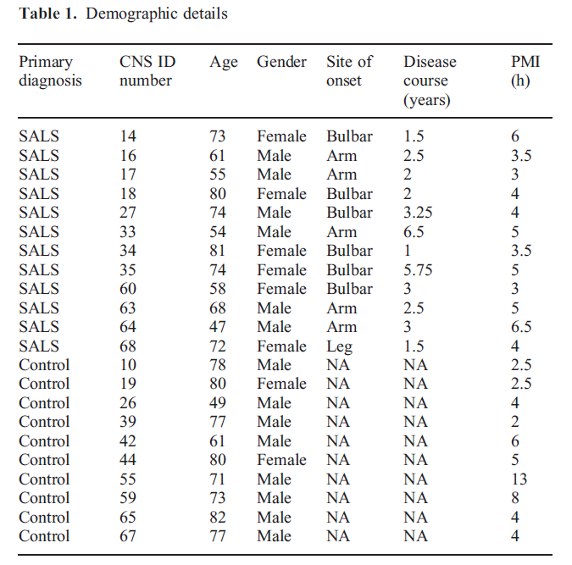
Demographic Details
12 sporadic ALS and 10 control lumbar spinal cords acquired by a rapid autopsy system
SALS tissue acquired from patients who met El Escorial criteria for definite ALS
Control tissue was acquired from hospital’s critical care unit when life support was withdrawn, from hospice patient, and from Pennsylvania Tissue Repository
Tissue collections (control and ALS) completed within 6 hours of death

Slide 5
Objectives
Authors’ believed that alternative exon splicing could be a major factor in ALS
Evidence of genes encoding RNA processing proteins in ALS and other motor neuron degenerative disorders
Increasing evidence of abnormalities of RNA processing and exon splicing in ALS
ALS progresses in a manner conducive to functional genomics analysis
TDP-43 has known functions in RNA processing and regulation of splicing and incorrectly localizes the nucleus to the cytoplasm
Suggesting pre-mRNA functions are no functioning correctly
Authors’ used exon arrays to explore the pathogenesis of ALS
Notes:
References:
Lagier-Tourenne, Clotilde, and Don W. Cleveland. "Rethinking als: The fus about tdp-43." Cell 136.6 (2009): 1001-1004.
Rabin, Stuart J., et al. "Sporadic ALS has compartment-specific aberrant exon splicing and altered cell–matrix adhesion biology." Human molecular genetics 19.2 (2010): 313-328.

Slide 6
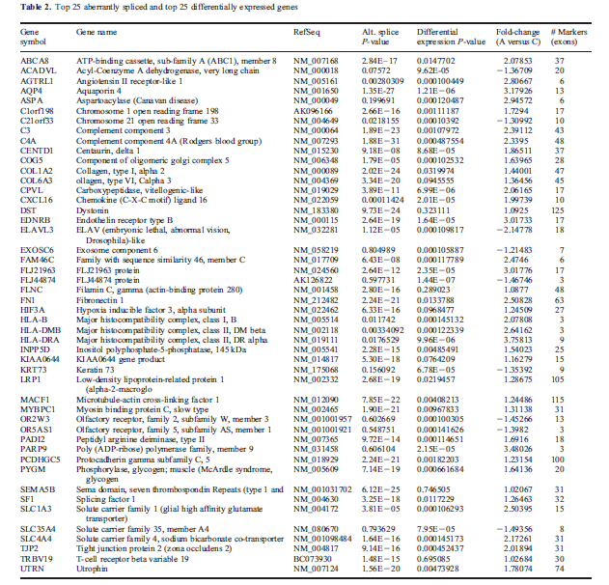
Authors’ Results & Conclusions I
ANOVA-based analysis generating P-values based on the probability of aberrant splicing occurring
Permutation testing for multiplicity correction and noise level estimation
411 aberrantly spliced and 148 differentially expressed genes (29 gene overlap)
In top 100 genes: 56% had changes in internal exons; 51% in 5’ regions; 36% in 3’ regions; 42% in multiple regions
Notes:
References:
Rabin, Stuart J., et al. "Sporadic ALS has compartment-specific aberrant exon splicing and altered cell–matrix adhesion biology." Human molecular genetics 19.2 (2010): 313-328.

Slide 7
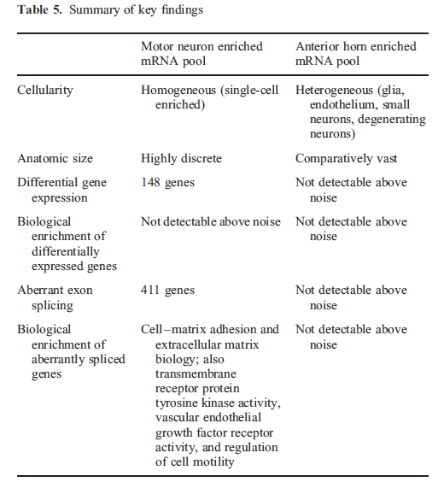
Authors’ Results & Conclusions II
33 significant pathways at data-specific 5% noise level threshold of P~10⁻²⁰
111 unique genes
Enrichment in motor neuron pool related to cell adhesion and ECM biology
Cell-matrix and cell-substrate adhesion most significant
Most genes were upregulated
The same pattern of differential splicing and expression was NOT found in the anterior horn neurons
Compartment-specific findings
TARDBP/TDP-43 and targets were NOT differentially spliced and did not exhibit differential gene expression
8/12 candidate genes examined by qPCR were differentially spliced
Notes:
References:
Rabin, Stuart J., et al. "Sporadic ALS has compartment-specific aberrant exon splicing and altered cell–matrix adhesion biology." Human molecular genetics 19.2 (2010): 313-328.

Slide 8
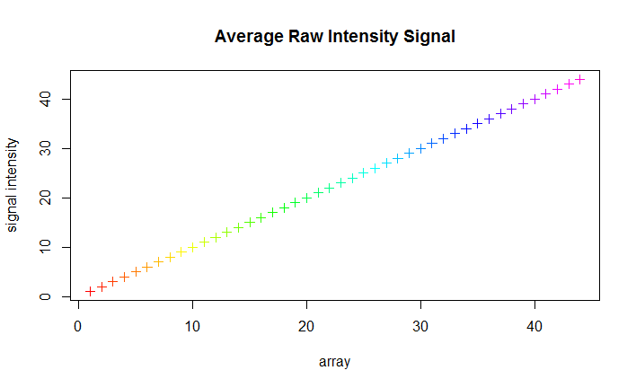
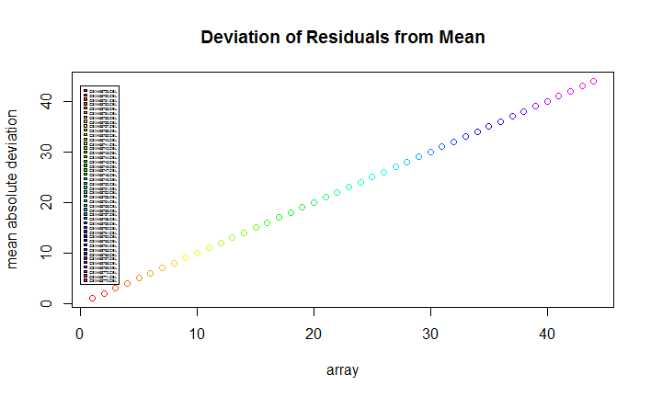
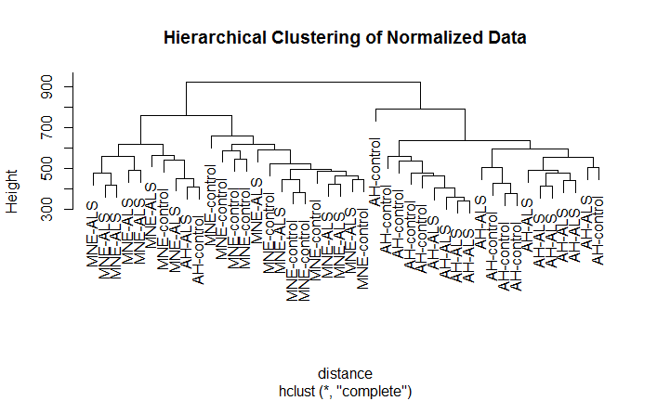
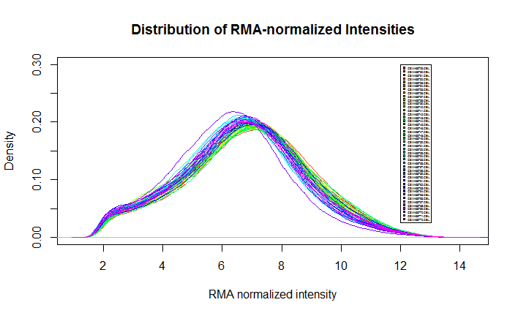
Quality Control & Outlier Analysis
Obtained CEL files for GSE18920 from GEO
Used APT to normalize data with RMA sketch
Examined average raw signal intensity, deviation of residuals from the mean, hierarchical clustering, and distribution of normalized intensities
Found no outliers
Filtered out undetected or cross-hybridizing probesets
Filtered for undetected genes
Notes:
References:
Lockstone, Helen E. "Exon array data analysis using Affymetrix power tools and R statistical software." Briefings in bioinformatics 12.6 (2011): 634-644.
Rabin, Stuart J., et al. "Sporadic ALS has compartment-specific aberrant exon splicing and altered cell–matrix adhesion biology." Human molecular genetics 19.2 (2010): 313-328.

Slide 9
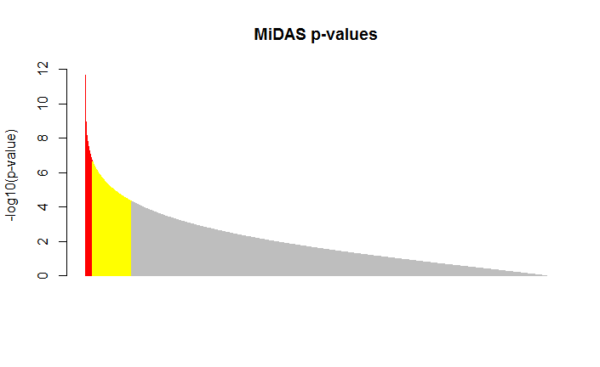
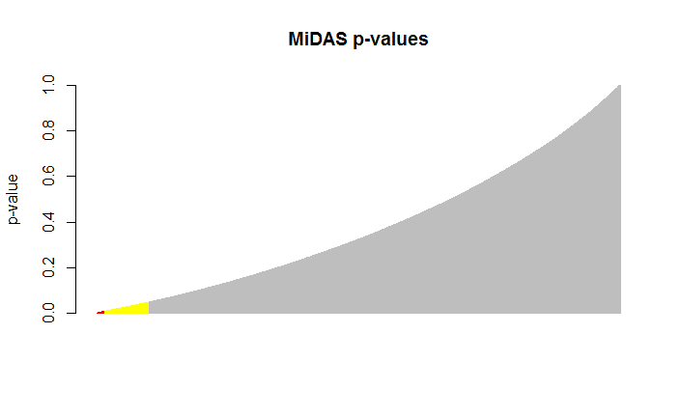
Splicing Analysis & Multiplicity Correction
After outlier analysis and filtering, data was fed into MiDAS for splicing analysis
17963 p-values significant at the 0.05 level (yellow), 2723 at 0.01 (red), and 56 at 0.001
Classical multiplicity correction methods like FDR were too strict
Permutation method was used for multiplicity correction, but did not produce any significant results where p-value < 0.01
Notes:
MiDAS was also used with only two groups (instead of four), but produced no significant p-values, indicating compartment-specific effects, in accordance with the authors’ results.
References:
Rabin, Stuart J., et al. "Sporadic ALS has compartment-specific aberrant exon splicing and altered cell–matrix adhesion biology." Human molecular genetics 19.2 (2010): 313-328.

Slide 10
Top 20 Differentially Spliced Exons
NM_000702 // ATP1A2 /// ENST00000361216 // ATP1A2 /// BC052271 // ATP1A2 /// ENST00000472488 // ATP1A2 /// ENST00000392233 // ATP1A2
ENST00000366663 // C1orf198 /// ENST00000470540 // C1orf198 /// NM_032800 // C1orf198 /// NM_001136494 // C1orf198 /// BC066649 // C1orf198
NM_016369 // CLDN18 /// NM_001002026 // CLDN18 /// ENST00000343735 // CLDN18 /// ENST00000183605 // CLDN18 /// BC146668 // CLDN18 /// ENST00000536138 // CLDN18 /// ENST00000479660 // CLDN18
NM_021101 // CLDN1 /// ENST00000295522 // CLDN1 /// AF114837 // CLDN1 /// ENST00000545382 // CLDN1
NM_021072 // HCN1 /// ENST00000303230 // HCN1 /// AF488549 // HCN1
---
NM_000883 // IMPDH1 /// NM_183243 // IMPDH1 /// NM_001102605 // IMPDH1 /// NM_001142573 // IMPDH1 /// NM_001142574 // IMPDH1 /// NM_001142575 // IMPDH1 /// ENST00000338791 // IMPDH1 /// ENST00000354269 // IMPDH1 /// ENST00000343214 // IMPDH1 /// ENST00000348127 // IMPDH1 /// ENST00000419067 // IMPDH1 /// ENST00000496200 // IMPDH1 /// BC033622 // IMPDH1 /// ENST00000469328 // IMPDH1 /// ENST00000484496 // IMPDH1 /// ENST00000378717 // IMPDH1
NM_003311 // PHLDA2 /// ENST00000314222 // PHLDA2 /// AF019953 // PHLDA2 /// AF001294 // PHLDA2 /// AF035444 // PHLDA2 /// BC005034 // PHLDA2 /// AK223027 // PHLDA2
NM_006500 // MCAM /// ENST00000264036 // MCAM /// BC056418 // MCAM /// AK291571 // MCAM /// AF089868 // MCAM /// M29277 // MCAM /// M28882 // MCAM /// AK128335 // MCAM /// ENST00000528533 // MCAM /// ENST00000527913 // MCAM /// ENST00000528502 // MCAM
NM_001037558 // HEPN1 /// NM_152722 // HEPACAM /// ENST00000298251 // HEPN1 /// ENST00000298251 // HEPACAM /// ENST00000408930 // HEPN1 /// AK122595 // HEPACAM
NM_194286 // SRRM4 /// ENST00000267260 // SRRM4 /// BC152471 // SRRM4
NM_001478 // B4GALNT1 /// ENST00000341156 // B4GALNT1 /// BC029828 // B4GALNT1 /// M83651 // B4GALNT1 /// AK293432 // B4GALNT1 /// AK299845 // B4GALNT1 /// AK289690 // B4GALNT1 /// AK302503 // B4GALNT1 /// AB209460 // B4GALNT1 /// ENST00000553142 // B4GALNT1 /// ENST00000552798 // B4GALNT1 /// ENST00000449184 // B4GALNT1 /// ENST00000548888 // B4GALNT1 /// ENST00000551925 // B4GALNT1 /// ENST00000418555 // B4GALNT1 /// ENST00000550764 // B4GALNT1 /// ENST00000552350 // B4GALNT1
NM_024042 // METRN /// ENST00000568223 // METRN /// BC000662 // METRN /// ENST00000564661 // METRN /// ENST00000570132 // METRN
NM_001033551 // TOM1L2 /// NM_001082968 // TOM1L2 /// ENST00000379504 // TOM1L2 /// ENST00000318094 // TOM1L2 /// AF467441 // TOM1L2 /// ENST00000478943 // TOM1L2 /// ENST00000395739 // TOM1L2 /// ENST00000535933 // TOM1L2 /// ENST00000486413 // TOM1L2
ENST00000398411 // CST3 /// ENST00000376925 // CST3 /// ENST00000398409 // CST3 /// NM_000099 // CST3 /// BT006839 // CST3
NM_003657 // BCAS1 /// ENST00000395961 // BCAS1 /// BC126346 // BCAS1 /// ENST00000371440 // BCAS1
NM_001958 // EEF1A2 /// ENST00000298049 // EEF1A2 /// ENST00000217182 // EEF1A2 /// BC110409 // EEF1A2
NM_019601 // SUSD2 /// ENST00000358321 // SUSD2 /// AK126105 // SUSD2 /// ENST00000463101 // SUSD2
NM_019601 // SUSD2 /// ENST00000358321 // SUSD2 /// AK126105 // SUSD2 /// ENST00000463101 // SUSD2
NM_006941 // SOX10 /// ENST00000396884 // SOX10 /// ENST00000360880 // SOX10 /// BC007595 // SOX10 /// ENST00000416937 // SOX10 /// ENST00000427770 // SOX10

Slide 11
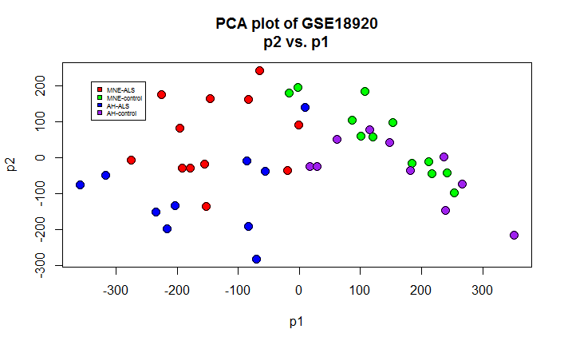
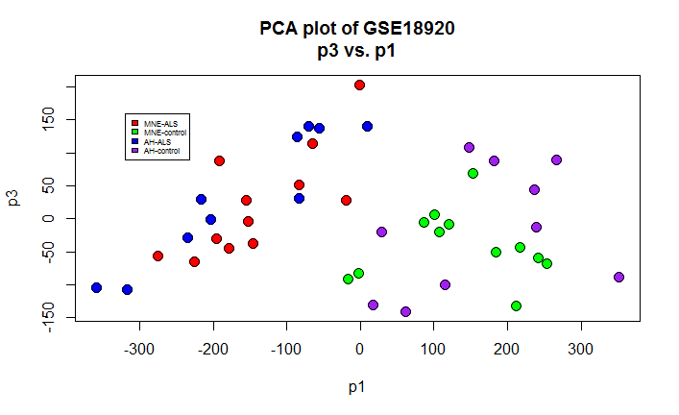
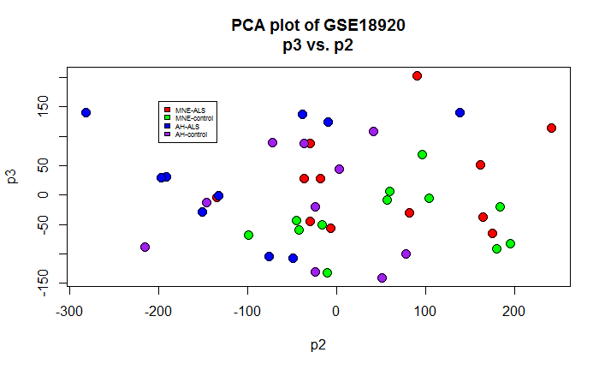
Dimensionality Reduction & Visualization
Performed PCA for dimensionality reduction and visualization of conditions
PCA plots demonstrate a clear difference between the ALS and control groups and a less clear difference between tissue types within groups
Notes:
References:
Rabin, Stuart J., et al. "Sporadic ALS has compartment-specific aberrant exon splicing and altered cell–matrix adhesion biology." Human molecular genetics 19.2 (2010): 313-328.

Slide 12
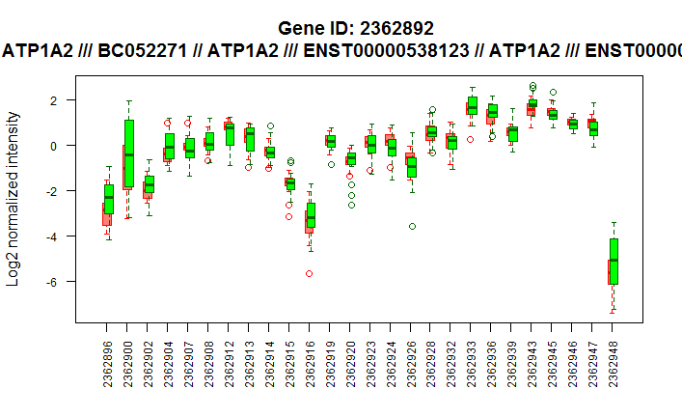
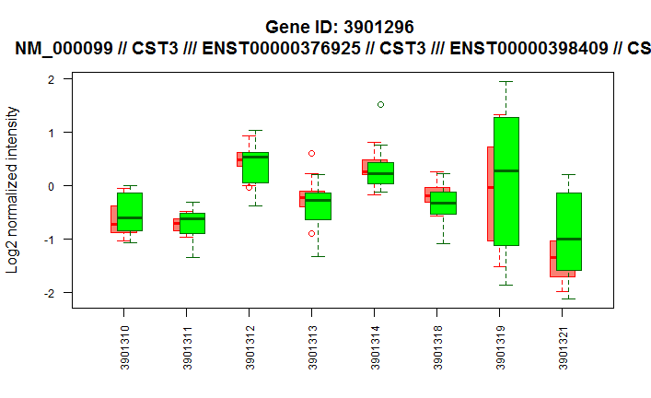
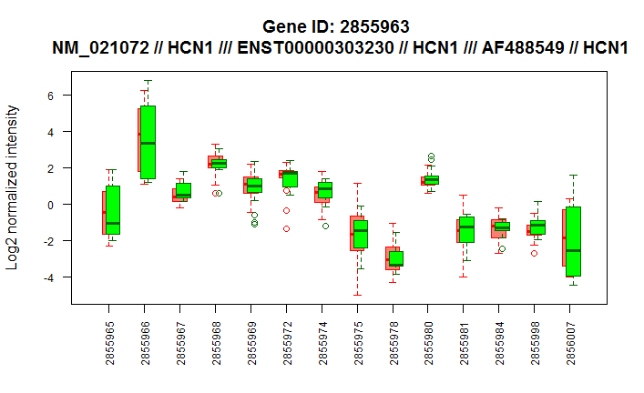
Results & Conclusions: Exon Visuals
The top 3 differentially spliced genes were visualized
In the visuals below, red is for ALS, green for controls
Notes:
References:
Rabin, Stuart J., et al. "Sporadic ALS has compartment-specific aberrant exon splicing and altered cell–matrix adhesion biology." Human molecular genetics 19.2 (2010): 313-328.

Slide 13
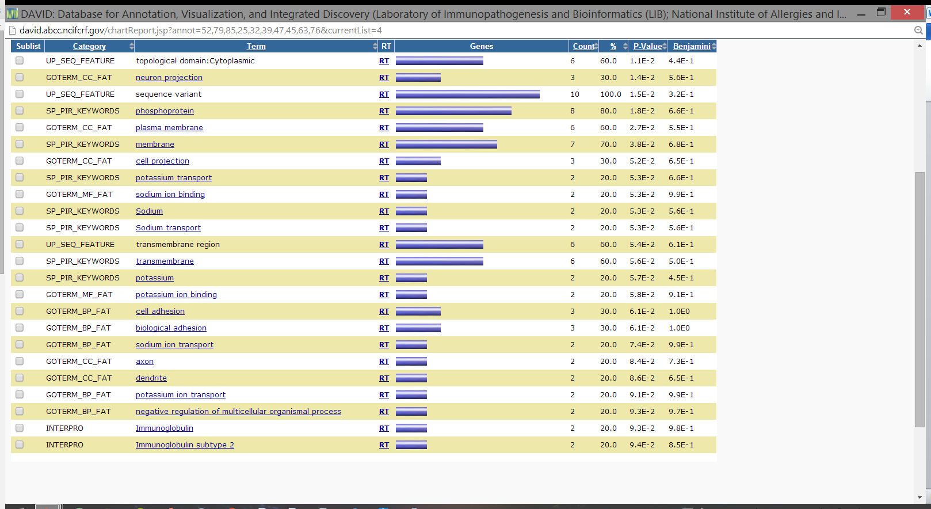
Results & Conclusions: Pathways
DAVID was used for pathway analysis
Pathways for cell adhesion and ECM biology were identified, in accordance with the authors’ results
Annotation table for top 10 genes is below
Notes:
References:
Huang, Da Wei, Brad T. Sherman, and Richard A. Lempicki. "Systematic and integrative analysis of large gene lists using DAVID bioinformatics resources." Nature protocols 4.1 (2008): 44-57.
Rabin, Stuart J., et al. "Sporadic ALS has compartment-specific aberrant exon splicing and altered cell–matrix adhesion biology." Human molecular genetics 19.2 (2010): 313-328.

Slide 14
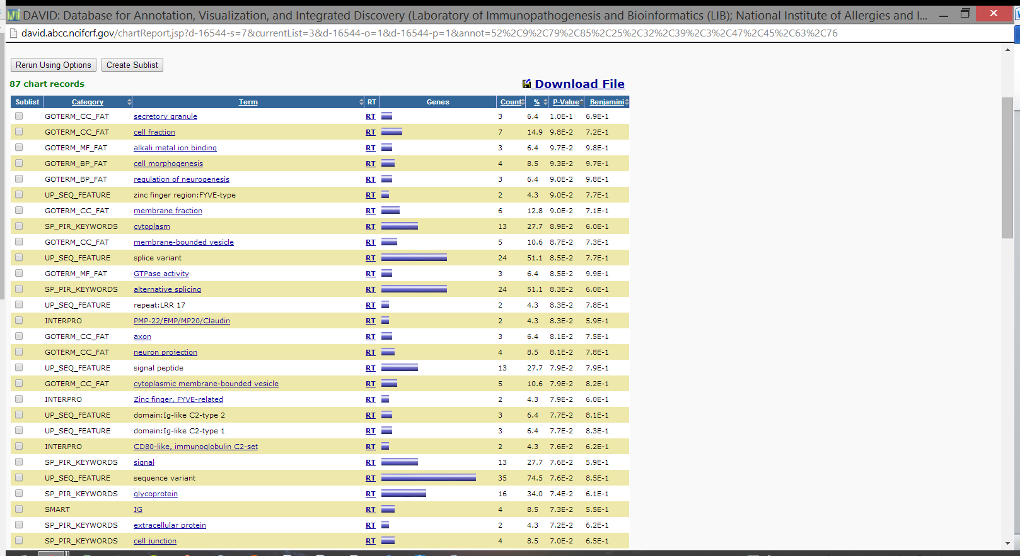
Results & Conclusions: Pathways
Using the top 57 genes (p<0.001) for DAVID analysis produced results tied to cell adhesion and ECM biology as well
Notes:
References:
Huang, Da Wei, Brad T. Sherman, and Richard A. Lempicki. "Systematic and integrative analysis of large gene lists using DAVID bioinformatics resources." Nature protocols 4.1 (2008): 44-57.
Rabin, Stuart J., et al. "Sporadic ALS has compartment-specific aberrant exon splicing and altered cell–matrix adhesion biology." Human molecular genetics 19.2 (2010): 313-328.

Slide 15
Critical Summary
The study could be completed again with higher power
Only 10 permutations per permutation test can be considered too few
Significant bias may be introduced when choosing which genes to analyze with qPCR
Lack of details pertaining to bioinformatics analyses precludes exact reproduction of results
In general, results of the analysis presented here concur with the authors’ results
Compartment-specific effects are clearly very important and it is important that the authors constructed a study to discern this
Overall, a useful study that confirms the importance of alternative splicing in ALS (and maybe other motor neuron degenerative diseases)
Notes:
References:
Rabin, Stuart J., et al. "Sporadic ALS has compartment-specific aberrant exon splicing and altered cell–matrix adhesion biology." Human molecular genetics 19.2 (2010): 313-328.

Slide 16
Future Research
TARDBP/TDP-43 and targets were NOT differentially spliced and did not exhibit differential gene expression
However, it is assumed that these are involved in splicing in ALS
Other studies focusing on compartment specific differential splicing
The exon array technology is clearly very useful and will likely produce many useful insights as more and more studies are conducted using the platform
Notes:
References:
Rabin, Stuart J., et al. "Sporadic ALS has compartment-specific aberrant exon splicing and altered cell–matrix adhesion biology." Human molecular genetics 19.2 (2010): 313-328.

Slide 17
References
Benson, Dennis A., et al. "GenBank." Nucleic acids research 27.1 (1999): 12-17.
Huang, Da Wei, Brad T. Sherman, and Richard A. Lempicki. "Systematic and integrative analysis of large gene lists using DAVID bioinformatics resources." Nature protocols 4.1 (2008): 44-57.
Lagier-Tourenne, Clotilde, and Don W. Cleveland. "Rethinking als: The fus about tdp-43." Cell 136.6 (2009): 1001-1004.
Lockstone, Helen E. "Exon array data analysis using Affymetrix power tools and R statistical software." Briefings in bioinformatics 12.6 (2011): 634-644.
Rabin, Stuart J., et al. "Sporadic ALS has compartment-specific aberrant exon splicing and altered cell–matrix adhesion biology." Human molecular genetics19.2 (2010): 313-328.
Rowland, Lewis P., and Neil A. Shneider. "Amyotrophic lateral sclerosis." New England Journal of Medicine 344.22 (2001): 1688-1700.

